Slide 1
Beg, Borrow, and Steal
Transformative Google tools you need to pirate
http://bit.ly/bbsmays

Slide 2
Session Expectations
http://bit.ly/bbsmays
Learning Outcomes
Transform work in the areas of productivity, management, and presentation.
Enlist a different way for awesome digital display
Crush video tutorials or announcements with new tools
We will not discuss everything you see here… and that’s okay! Use this is a jumping off point to drive conversation.
Session Description
You don’t know what you don’t know. An entire world of free online tools exists in the far reaches of the interweb that you never knew were out there. Thousands of Chrome Apps and Extensions are waiting that will leave you saying, “Where has this been my whole life?!” Attendees will explore 20+ chrome extensions that are immediately useful as well as other incredibly useful hacks from all over the internet that I've had to beg, borrow, and steal to acquire.
This presentation is free to use under Creative Commons Attribution license.

Slide 3
Hello!
http://bit.ly/bbsmays
I am Matthew Mays
Google for Education Certified Educator
Perry Local Schools - Stark County
You can find me at @i_am_mays

Slide 4
“Teacher” World vs.
“Tech” World
http://bit.ly/bbsmays
Why doesn’t the other side understand my role?
How does this struggle play out in your district or workplace?
Take 2:00 with someone you don’t know.

Slide 5
You say potato, I say potato.
http://bit.ly/bbsmays
Productivity
Management
Presentation
We are all pressed for time and resources. Efficiency is king when it comes to technology.
Who has what and where is it located? Keeping your sanity in a technological age is essential.
Make it beautiful and accessible for all! Free tools are in GSuite to help make your work shine.
1
2
3

Slide 6
Make the Jump
Please click the headers below to go directly to a specific section
http://bit.ly/bbsmays
Productivity
Work Faster
Work Smarter
Help everyone understand flow
7-17
Management
Master “behind the scenes”
Push items to end users
Be proactive
18-29
Presentation
Google Sites
Google Sign Builder
Effectively communicate to the world
30-37
Note: Much of what you are about to hear is customized to the Chrome Web Browser and GSuite Tools. Be sure that you are signed in to Chrome and that you sync profiles across devices for the best experience.

Slide 7
Productivity Tools
http://bit.ly/bbsmays
Get the most out of working the least

Slide 8
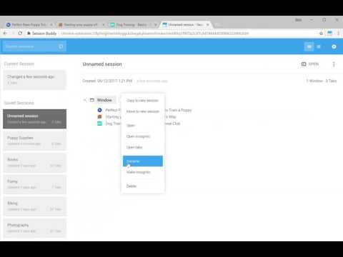
Session Buddy
http://bit.ly/bbsmays
Description
Session Buddy is a unified session manager and bookmark manager. Save open tabs and restore them later. Great for freeing up memory and avoiding clutter. Recover open tabs after a crash or when your OS restarts your computer. Manage open windows and tabs in one place. Organize saved tabs by topic. Search open and saved tabs to quickly find what you're looking for. Export tabs in a variety of formats suitable for emails, documents, and posts.
Watch a demo:
Get Session Buddy

Slide 9
Extensity
http://bit.ly/bbsmays
Description
The ultimate tool for lightning fast enabling and disabling all your extensions for Google Chrome. Just enable the extension when you want to use it, and disable when you want to get rid of it for a little while. You can also launch Chrome Apps right from the list. Keep your browser lean and fast - disable extensions that you won't use right away.
Watch a demo:
Get Extensity

Slide 10
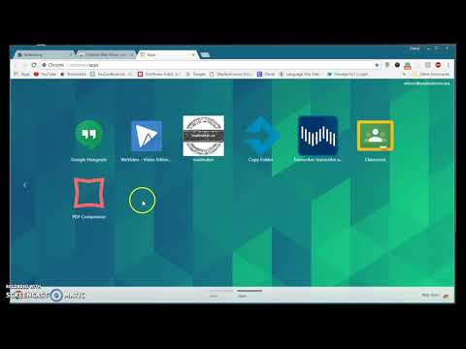
Small PDF
http://bit.ly/bbsmays
Description
Convert, compress, merge, split and edit your PDF files. Transition PDFs into most known file types and back again in a flash.
Watch a demo:
Get Smallpdf

Slide 11
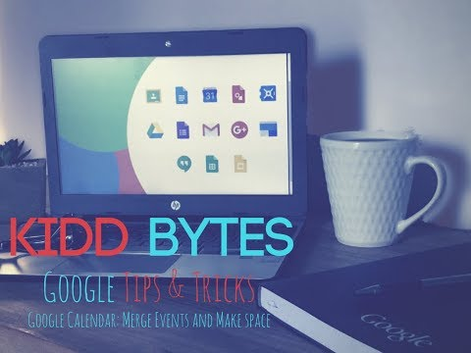
Event Merge for Google Calendar
http://bit.ly/bbsmays
Description
When using Google Calendar™ you may have one event on multiple calendars. For instance on your work and personal calendar, on your work calendar and your team's shared calendar, or on many co-work's calendars. These can clutter up your calendar and make it hard to read. This extension merges all those separate events into one event, and gives it strips with all the individual calendars' colors.
Watch a demo:
Get Event Merge

Slide 12
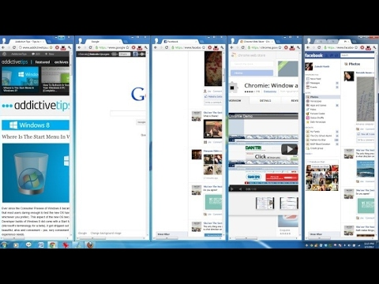
Tab Resize
http://bit.ly/bbsmays
Description
A simple extension designed to provide ease in resizing your tabs. A set of default layouts are provided but you can add and remove from the list of layouts to fit your needs. With multiple monitor support you can move windows from one screen to the next with ease.
Watch a demo:
Get Tab Resize

Slide 13
Grammarly
http://bit.ly/bbsmays
Description
Grammarly's free writing app makes sure everything you type is easy to read, effective, and mistake-free. Adding Grammarly to Chrome means that your spelling and grammar will be vetted on Gmail, Facebook, Twitter, Linkedin, Tumblr, and nearly everywhere else you write on the web.
Watch a demo:
Get Grammarly

Slide 14
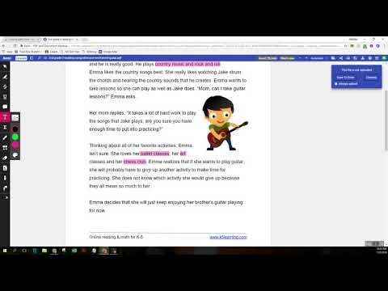
Kami
http://bit.ly/bbsmays
Description
View, annotate, share and collaborate your PDF and documents on Chrome. Kami is the most popular and highly rated document app in the market.
Works with:
• Google Classroom
• Google Drive
Watch a demo:
Get Kami

Slide 15
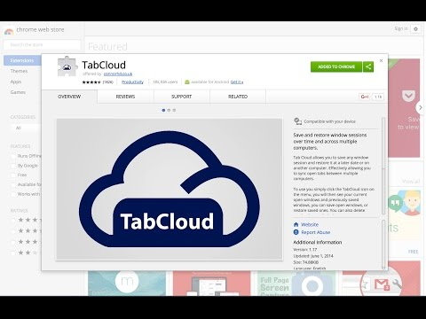
Tab Cloud
http://bit.ly/bbsmays
Description
Save and restore window sessions over time and across multiple computers. Tab Cloud allows you to save any window session and restore it at a later date or on another computer. Effectively allowing you to sync open tabs between multiple computers.
Watch a demo:
Get Tab Cloud

Slide 16
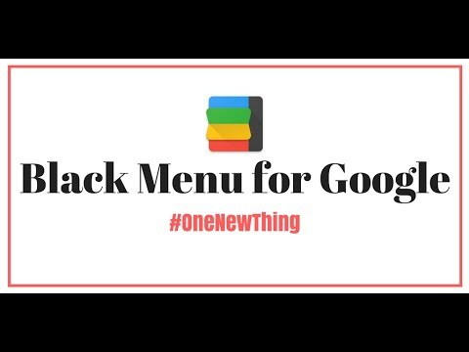
Black Menu
http://bit.ly/bbsmays
Description
Black Menu for Google gives you quick access to your favorite Google services with a convenient drop-down menu that lets you use Search, Google+, Translate, and many others without leaving the page you’re on. Click on menu items to get a small windowed preview or click on the open in new button on the right to open them in a new tab.
Watch a demo:
Get Black Menu

Slide 17
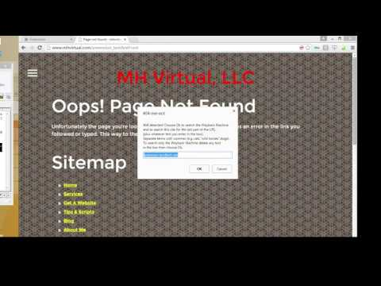
404 Me Not
http://bit.ly/bbsmays
Description
404-me-not saves you time by making it extremely easy to search for missing web pages. It will search both the Wayback Machine (a huge database of archived pages) and whatever search engine you choose, using the last part of the URL and keywords you supply as clues. Searches are triggered by clicking Ok on a popup that automatically shows when a 404 error (page not found) is detected or by dragging the offending link (and optionally the highlighted link text; this requires another extension).
Watch a demo:
Get 404 Me Not

Slide 18
Take a breath
http://bit.ly/bbsmays
Before we move on, take a minute to think about what you’ve just seen or heard and how it might apply to your role, district, or company. Feel free to discuss with those around you.

Slide 19
Management Tools
http://bit.ly/bbsmays
Effect change in the optimal way

Slide 20
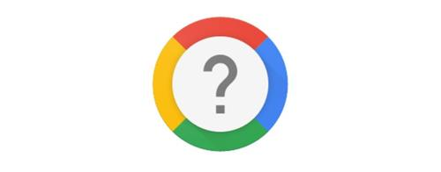
GSuite Training
http://bit.ly/bbsmays
Description
G Suite Training is a Chrome extension that offers simple and interactive training lessons to get you up and running fast with G Suite. Rich, interactive training! Whether you’re in Gmail, Calendar, Sheets, Slides, or Docs, you can learn and take actions, all at the same time.
Watch a demo:
Get GSuite Training

Slide 21
Web of Trust
http://bit.ly/bbsmays
Description
Ever wondered how to check if a website is safe? Get the community to do the website security checks for you. WOT protects you while you browse, warning you when you visit dangerous sites, scams, malware, phishing, rogue web stores, dangerous links, and more. Reputation icons are displayed next to search results, social media, email, and other popular sites to help you make informed decisions online.
Watch a demo:
Get Web of Trust

Slide 22
Fair AdBlocker (by Stands)
http://bit.ly/bbsmays
Description
Block unwanted ads, popups, tracking and malware (even on Youtube), speed up your browsing, block annoying ads, pop-ups and malware and protect your device from any security threats and protect your privacy from online tracking.
Watch a demo:
Get Fair AdBlocker

Slide 23
Adblock Plus
http://bit.ly/bbsmays
Description
Tired of ads on Chrome? Adblock Plus is an easy-to-use adblocker that blocks video and social media advertising. Adblock Plus will change the way you see the web. To use Adblock Plus, just click “add to Chrome.” Click on the ABP icon to see how many ads you have blocked, change your settings or report a bug. Adblock Plus supports the Acceptable Ads (AA) initiative. They are nonintrusive ads that do not disrupt your web experience. They are shown by default to support websites that rely on advertising revenue, while respecting consumer experience. AA can be turned off at any time for users who wish to block all ads. Learn more at https://adblockplus.org/acceptable-ads
Watch a demo:
Get Adblock Plus

Slide 24
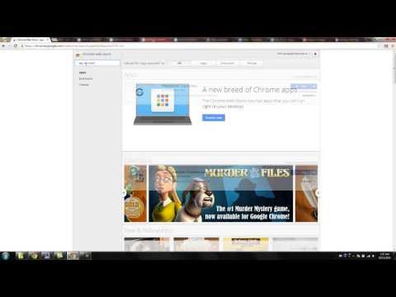
Apps Launcher
http://bit.ly/bbsmays
Description
The downside to the waffle/box of boxes is the fact you can't customize the shortcuts displayed in the app launcher. That's where this extension comes in. It allows you to customize the app launcher and add more than 250 Google shortcuts. And it is not limited to these 250 Google shortcuts; the extension also allows you to create custom shortcuts to every website you want.
Watch a demo:
Get App Launcher

Slide 25
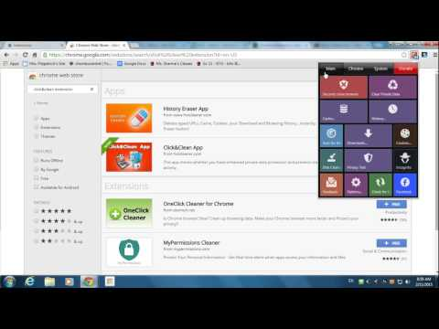
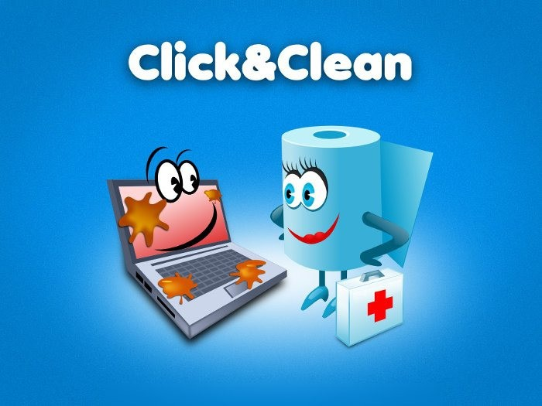
Click & Clean
http://bit.ly/bbsmays
Description
Deletes typed URLs, Cache, Cookies, your Download and Browsing History...instantly, with just one click. Scan your PC for Malware, delete your browsing history, remove download history, erase temporary files, clear cookies and empty cache, and protect your privacy by cleaning up all traces of your internet activity.
Watch a demo:
Get Click & Clean

Slide 26
Draftback
http://bit.ly/bbsmays
Description
Draftback lets you play back the revision history of any Google Doc you can edit. With Draftback, your data is kept entirely private. Draftback was purposely designed so that you could play back your own docs without having to share them with a third party. Draftback only needs access to docs.google.com to get the revision data for playback—but that data never leaves your own browser.
Watch a demo:
Get Draftback

Slide 27
Phish Alert by KnowBe4
http://bit.ly/bbsmays
Description
Chrome Extension to add phish reporting functionality to Gmail.
Phish Alert Button for Gmail. Report your suspected phishing emails with this easy to use toolbar button!
Watch a demo:
Get Phish Alert

Slide 28
Boomerang
http://bit.ly/bbsmays
Description
Boomerang allows you to schedule messages to be sent or returned at a later date. Write a message now, send it whenever, even if you're not online. Track messages to make sure you hear back, and schedule reminders right inside Gmail
Watch a demo:
Get Boomerang

Slide 29
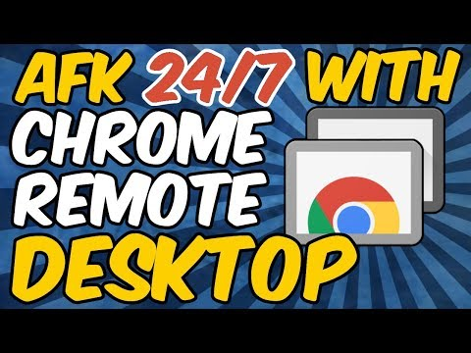
Chrome Remote Desktop
http://bit.ly/bbsmays
Description
Chrome Remote Desktop allows users to remotely access another computer through Chrome browser or a Chromebook. Computers can be made available on an short-term basis for scenarios such as ad hoc remote support, or on a more long-term basis for remote access to your applications and files. All connections are fully secured.
Watch a demo:
Get Chrome Remote Desktop

Slide 30
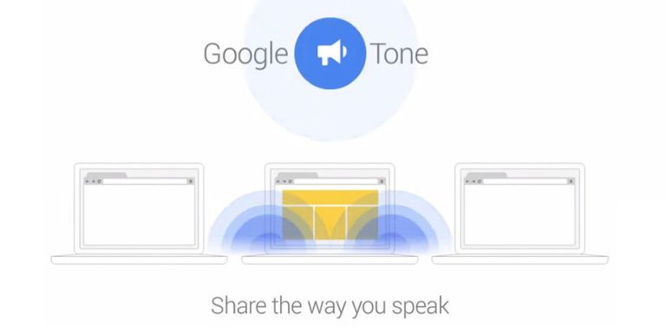
Google Tone
http://bit.ly/bbsmays
Description
Google Tone turns on your computer's microphone (while the extension is on) and uses your computer's speakers to exchange URLs with nearby computers connected to the Internet. You can use Google Tone to send the URL for any web page, including news stories, pictures, documents, blog posts, products, YouTube videos, recipes—even search results. Any computer within earshot (including over a phone or Hangout) that also has the Google Tone extension installed and turned ON can receive a Google Tone notification.
Watch a demo:
Get Google Tone

Slide 31
Take a breath
http://bit.ly/bbsmays
Before we move on, take a minute to think about what you’ve just seen or heard and how it might apply to your role, district, or company. Feel free to discuss with those around you.

Slide 32
Presentation Tools
http://bit.ly/bbsmays
Make your work stand out

Slide 33
Bitly
http://bit.ly/bbsmays
Description
Scrap long links! Shorten and brand your links in one click. Automatically create Bitlinks with your unique domain and customize the back half of new Bitlinks all within the extension. Share your links and let us help with the rest. Data for Bitlinks you create through the extension can be accessed directly through the Bitly app.
Watch a demo:
Get Bitly

Slide 34
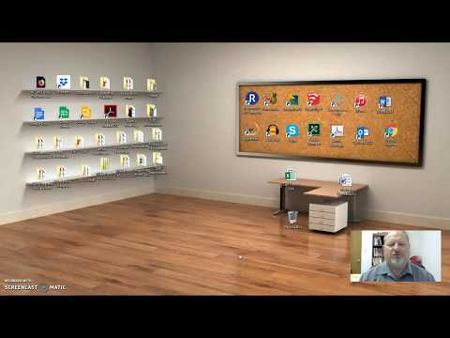
Awesome Screenshot
http://bit.ly/bbsmays
Description
Screencast, record screen as video. Screen capture for full page, annotate, blur sensitive info, and share with one-click uploads.
Capture all or part of any web page. Add annotations, comments, blur sensitive info, and share with one-click uploads. Now with free desktop capture! Previously premium features are now completely free.
Watch a demo:
Get Awesome Screenshot

Slide 35
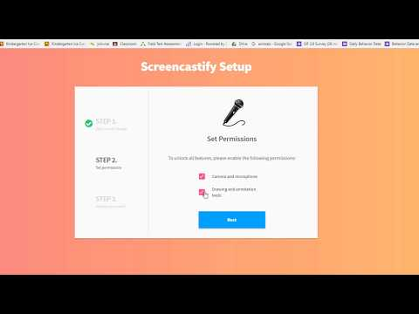
Screencastify
http://bit.ly/bbsmays
Description
Screencastify is the easiest way to Record, Edit, Annotate, Store, and Share video screen recordings. Record a specific tab, or your whole desktop at the click of a button.
Watch a demo:
Get Screencastify

Slide 36
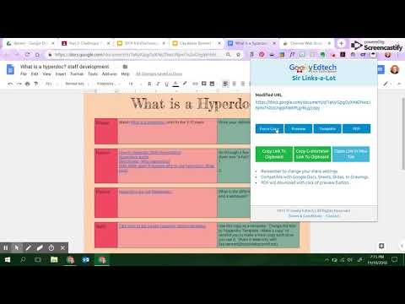
Sir Links-a-lot
http://bit.ly/bbsmays
Description
The ultimate Google Apps URL modifier. Do you like to manipulate Google app URL's to meet the needs of your students? Well, you are in luck because Sir Links-a-Lot extension has your back with big round buttons in your face to do all the work for you! Templates ~ Force a copy ~ Preview ~ PDF with just a click check this out!
Watch a demo:
Get Sir Links-a-lot

Slide 37
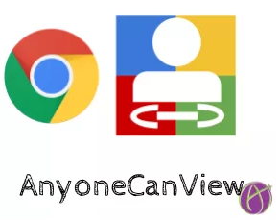
Anyone Can View
http://bit.ly/bbsmays
Description
Instantly change the sharing permissions of a Google Docs/Sheets/Slides/Drawing to "Anyone with the link can view".
This will open the viewing permissions to those outside of your domain or school. The link to the Google Doc is also automatically copied to your clipboard. This saves you from the extra step of copying the URL after you changed the sharing permissions.
Watch a demo:
Get AnyoneCanView

Slide 38
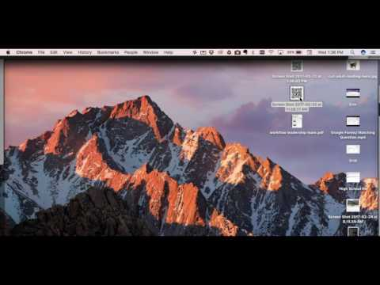
The QR Code Extension
http://bit.ly/bbsmays
Description
Generates a QR Code from the Page URL of the current tab with a single click. The QR Code is displayed inline in a small popup. Please note that this extension, unlike other extensions, does not require any special permissions (like access to your tabs and data). It is only loaded when you click on the button. So it does not have any unnecessary memory consumption and performance implications while not used. The QR code is generated completely offline. The URL of the page you visited is not sent over the network (except when you click on "Edit QR Code" - that opens www.the-qrcode-generator.com). So it's probably as good as it gets regarding privacy and security.
Watch a demo:
Get The QR Code Extension

Slide 39
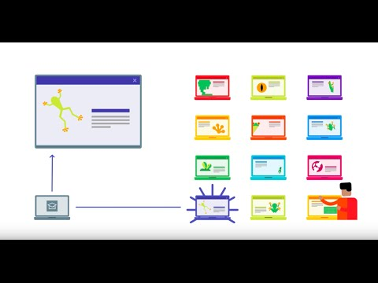
Google Cast for Education
http://bit.ly/bbsmays
Description
Cast for Education allows you to turn your computer into a wireless projector for screen sharing from another device. Just install the extension, give your device a name, and invite your students to cast. This extension requires that both parties have the extension added.
Watch a demo:
Get Google Cast

Slide 40
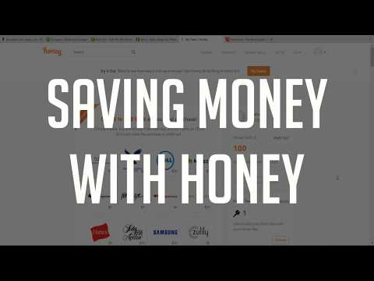
Honey
http://bit.ly/bbsmays
BONUS
Description
Stop searching for coupon codes and sales. Click on the Honey button during checkout and Honey will automatically apply coupon codes to your shopping cart.Click on the Honey button on a supported online store and instantly see all the coupons and sales available for the store.
Watch a demo:
Get Honey

Slide 41
Take a breath
http://bit.ly/bbsmays
Before we move on, take a minute to think about what you’ve just seen or heard and how it might apply to your role, district, or company. Feel free to discuss with those around you.

Slide 42
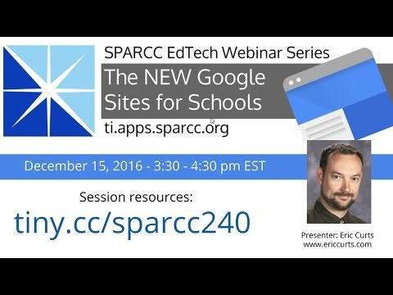
Google Sites
http://bit.ly/bbsmays
Place your screenshot here
No code necessary. No design theory needed. Create beautiful free websites for anyone or anything.
http://bit.ly/startsite2017
See some samples:
StarSprinkle Sweets
St. Joseph's Church - Massillon
Perry Technology Learning Center
Edison Track & Field

Slide 43
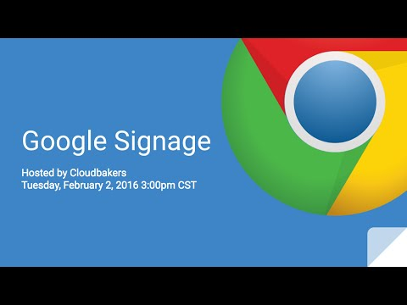
Digital Signage
http://bit.ly/bbsmays
Place your screenshot here
Chrome Sign Builder will absolutely transform communication as guests enter your buildings. Update and link Google Slides to create beautiful digital signage.
Digital Signage with Chrome Sign Builder

Slide 44
Same language
Align your goals
Find a medium
http://bit.ly/bbsmays
Different dialects
Tech and Non-Tech must play nicely
Enlist someone who communicates well with all

Slide 45
Thanks!
http://bit.ly/bbsmays
Any questions?
You can find me at:
@i_am_mays
matthew.mays@perrylocal.org
http://bit.ly/perrytlc
This document is licensed under a Creative Commons Attribution Non-Commercial 3.0 United States license. For more information about this license see http://creativecommons.org/licenses/by-nc/3.0/ (In short, you can copy, distribute, and adapt this work as long as you give proper attribution and do not charge for it.)

